Slide 1
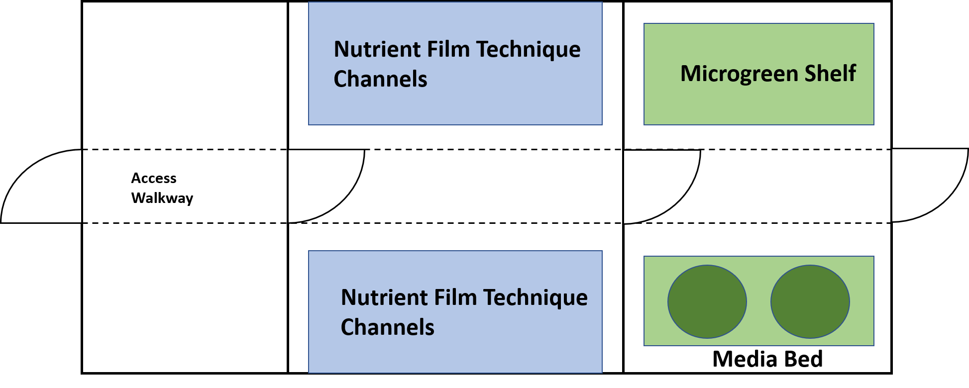
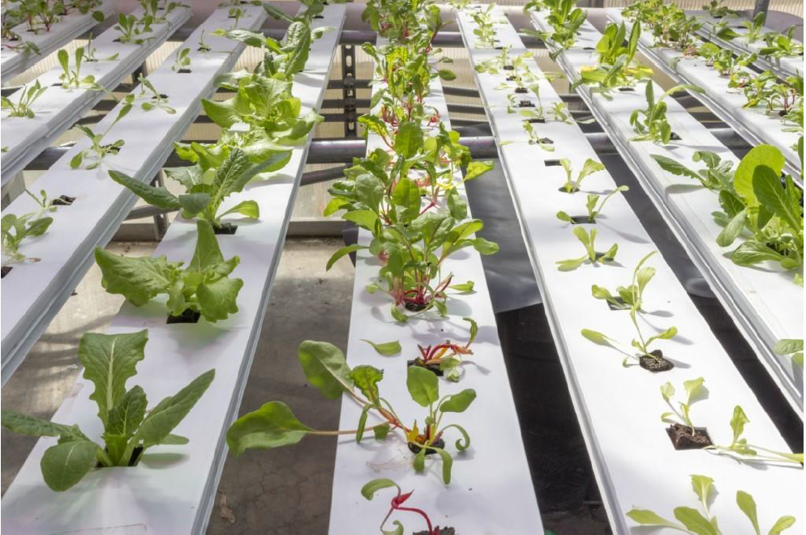

Autonomous Control & Monitoring for the Hydroponic Greenhouse at GMU
Venkata Sasikiran Veeramachaneni,
Harshith Kumar Thirumala,
Dinesh Kumar Karri
Electrical & Computer Engineering
George Mason University
October 20th, 2019
Organization of the greenhouse
NFT Channels

Slide 2
Hydroponic green house has three independent sections: NFT channels, Microgreen shelf, Media bed
Nutrient Film Technique Channels
Microgreen Shelf
Access Walkway
Nutrient Film Technique Channels
Media Bed

Slide 3
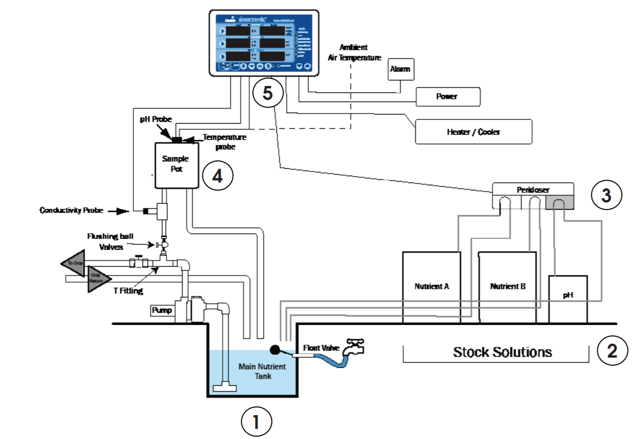
Remote monitoring of the NFT channels parameters is not possible with the existing Bluelab Dosetronic CropKing Controller
Notes:
Range resolution is the required minimum separation between closely spaced targets. Vlos is also known as range-rate or radial velocity

Slide 4
Proposed approach: Monitoring of the NFT system is done by relaying the data to a webApp using Smart IoT Devices and sensors
Sensor input
I2C protocol
FS
FS
Water Outlet
Water inlet
Water inlet
Water outlet
FS
Arduino Nano
FS
FS
FS
FS
1 | 1
1 | 1
1 | 1
1 | 0
FS
Sample Pot2
Sample Pot2
Arduino Mega with Ethernet shield
pH, EC, WT, WO
pH, EC, WT, WO
PR, AT, AQ
Gateway, Light control (PWM signal for relay)
FS: Flow Sensor; EC: electrical conductivity sensor, WT: Water temperature sensor, WO: water dissolved oxygen sensor, PR: Photo resistor, AT: Air temperature sensor, AQ: Air quality sensor, pH: pH level sensor

Slide 5
The IoT devices communicate to a Cloud Instance over a TCP connection for data analysis and real-time monitoring
Gateway
(Raspberry Pi 4)
Cloud:
Storage,
Computation & Analysis
TCP/IP
Dashboard
(webApp)

Slide 6
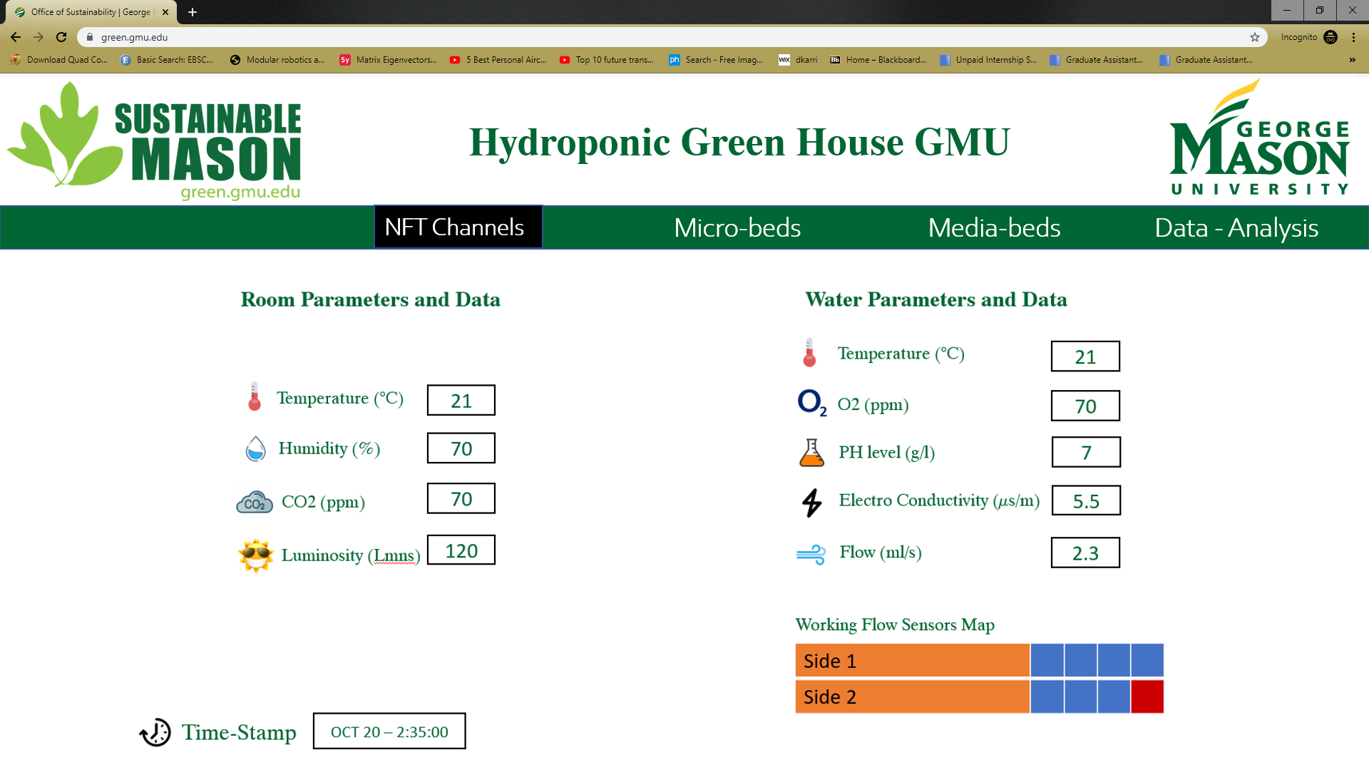

Slide 7
Hydroponic green house has three independent sections: NFT channels, Microgreen shelf, Media bed
Nutrient Film Technique Channels
Microgreen Shelf
Access Walkway
Nutrient Film Technique Channels
Media Bed

Slide 8

Monitoring and automatic control of the Media Bed system is done by using Smart IoT Devices and sensors
PR, AT, AQ
Arduino Mega with Ethernet shield
Gateway, Light control (PWM signal for relay)
pH, EC, WT, WO
Sample Pot2
Water inlet
SV
MS
MS: Moisture Sensor; EC: electrical conductivity sensor, WT: Water temperature sensor, WO: water dissolved oxygen sensor, PR: Photo resistor, AT: Air temperature sensor, AQ: Air quality sensor, pH: pH level sensor, SV: solenoid water valve

Slide 9
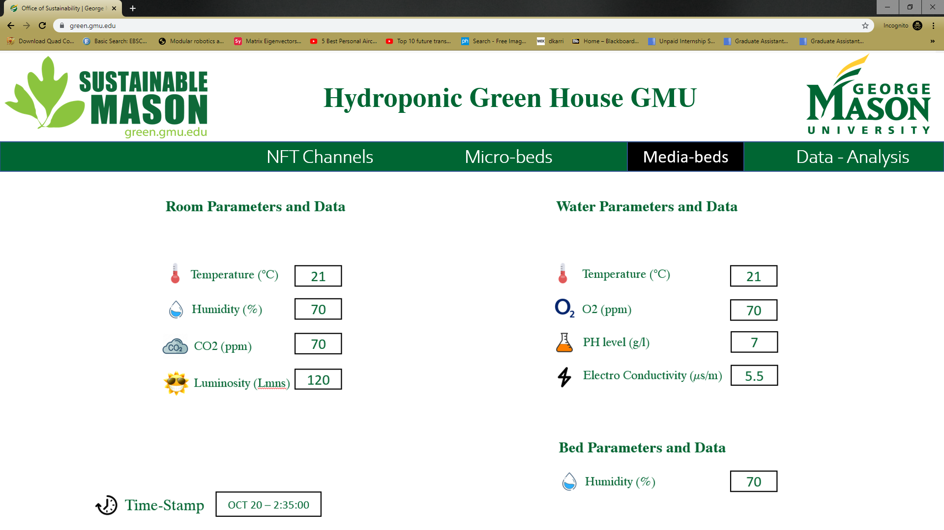

Slide 10
Hydroponic green house has three independent sections: NFT channels, Microgreen shelf, Media bed
Nutrient Film Technique Channels
Microgreen Shelf
Access Walkway
Nutrient Film Technique Channels
Media Bed

Slide 11
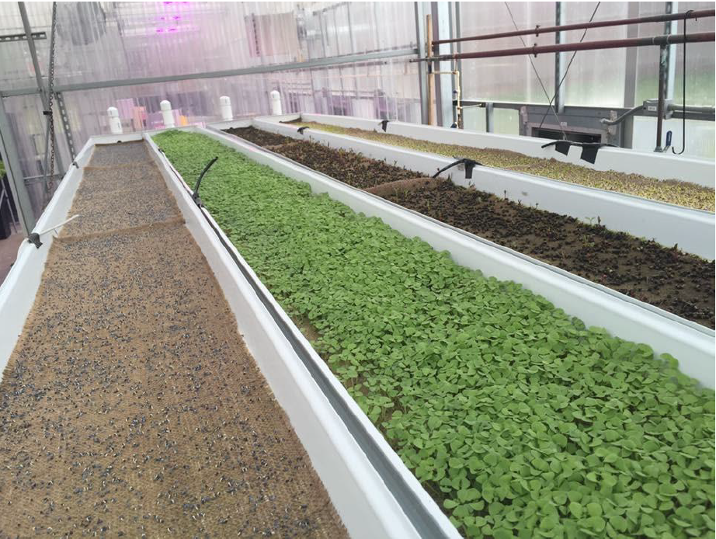
Monitoring and automatic control of the Microgreen shelf is done by using Smart IoT Devices and sensors
Gateway, Light control (PWM signal for relay)
PR, DHT, AQ
pH, WT, WO
Sample Pot
Arduino Mega with Ethernet shield
SV
SV
Water inlet
MS
MS
MS
SV
Water outlet
Reservoir
Microgreen shelf
WT: Water temperature sensor, WO: water dissolved oxygen sensor, PR: Photo resistor, DHT: Digital humidity and temperature sensor, AQ: Air quality sensor, pH: pH level sensor, MS: Moisture sensor, SV: Solenoid fluid valve

Slide 12
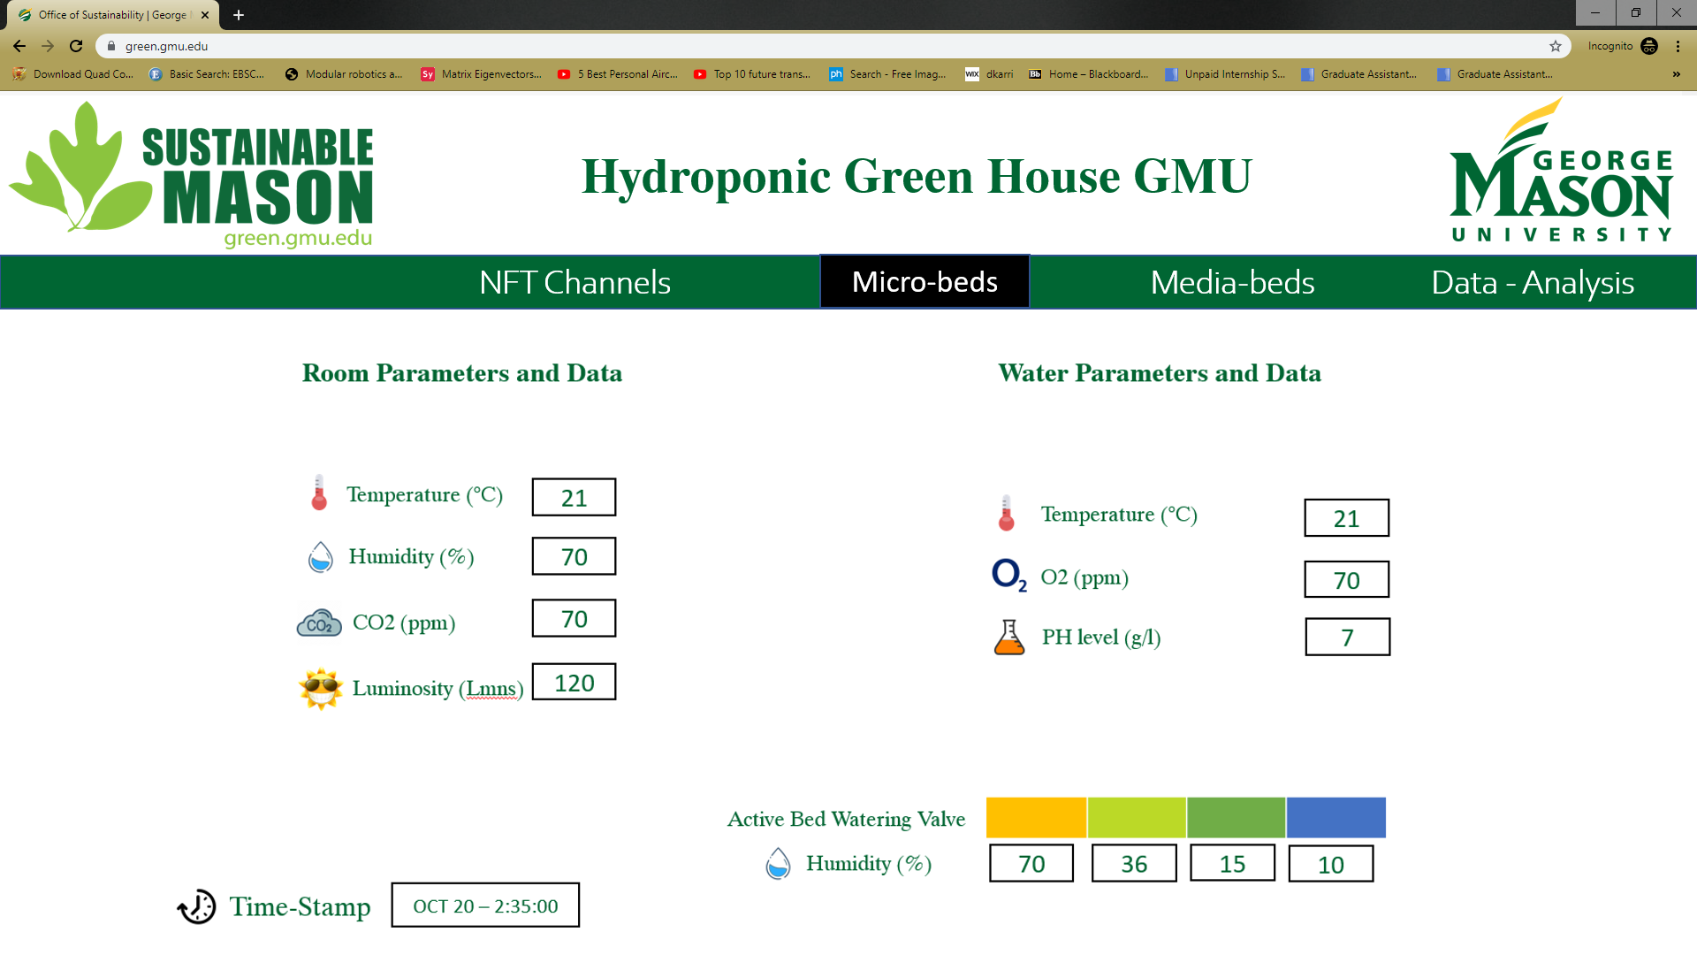

Slide 13
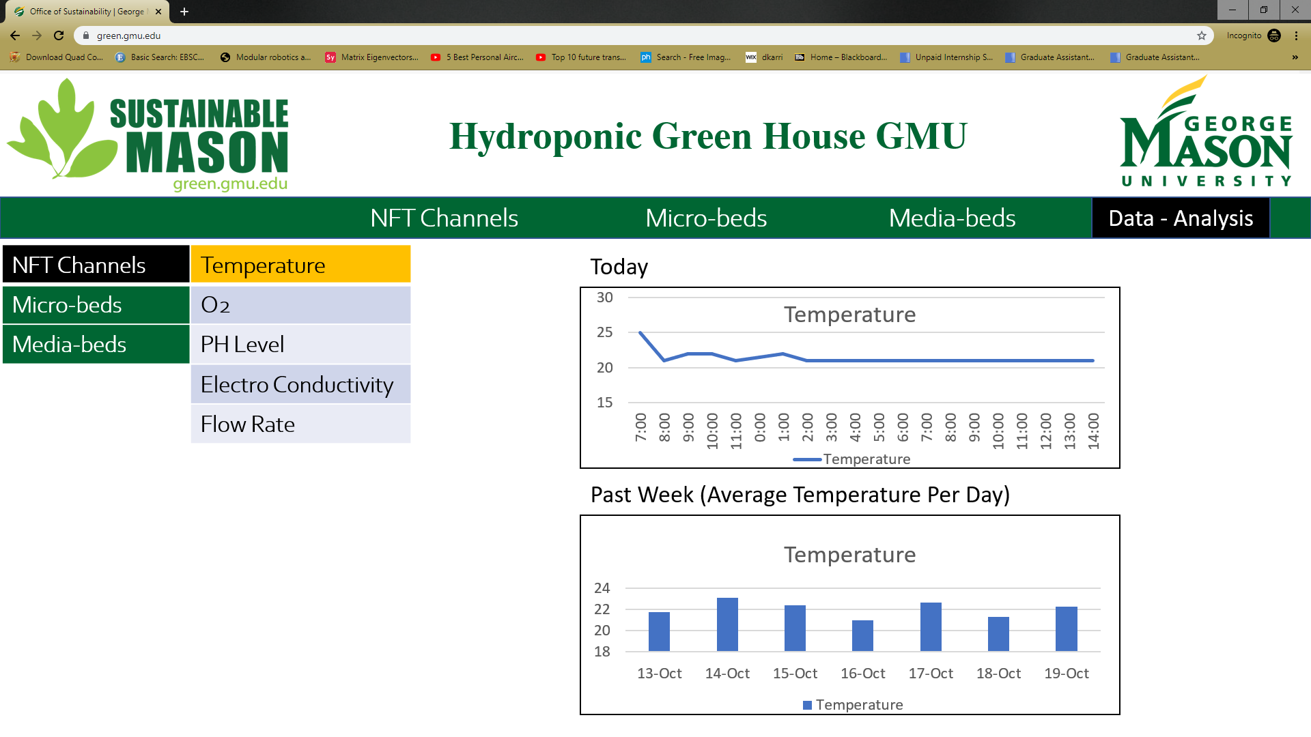

Slide 14
To Conclude: Implementation of the proposed monitoring and automatic control system costs $≈\$1000$
Smart Devices | Configuration | $ Price (per unit) | URL
Raspberry Pi | Raspberry Pi 4 - Model B 4GB RAM | $45.00 | Raspberry Pi
Arduino Mega 2560 | ATMega2560 | $38.50 | Arduino Mega 2560
Arduino Nano | ATMega328 | $22.00 | Arduino Nano
Arduino Ethernet Shield | Arduino Ethernet Shield 2 | $23.65 | Arduino Ethernet Shield
Sensors: | Part Name/Number | $ Price (per unit) | Communication Protocol | URL
CO2 Sensor (Air Quality Sensor) | Adafruit CCS811 | $19.95 | I2C | CO2 Sensor
Water Temperature Sensor | Sparkfun SEN-11050 | $11.95 | 1-Wire | Water Temperature Sensor
Dissolved Oxygen Sensor | DFRobot SEN0237-A | $169.00 | Analog Output | Dissolved Oxygen Sensor
Ambient Light Sensor | Adafruit VEML-7700 | $4.95 | I2C | Ambient Light Sensor
Soil Moisture Sensor | Adafruit STEMMA 4026 | $7.50 | I2C | Soil Moisture Sensor
Liquid Flow Meter | Adafruit Liquid Flow Meter 1/2" | $9.95 | Analog Output | Liquid Flow Meter
Web Programmable 16 Relay array | Control by Web X-332 | $549.00 | Ethernet | Control by Web
Single Relay Module | Tolako 5v Relay Module | $5.50 | Digital Control Signals | Single Relay Module
Humidity and Temperature Sensor | Adafruit HTU21D-F | $14.95 | I2C | Humidity & Temperature Sensor
Plastic Water Solenoid Valve | Plastic Water Solenoid Valve - 12V | $6.95 | Digital Control Signals | Plastic Water Valve
Water Conductivity Sensor | Model A1004V2 | $75.00 | Analog Output | Water Conductivity Sensor

Slide 15
Summary: Monitoring and Automatic control is integrated with the existing control system
All the beds in the garden require same set of parameters
With the Bluelab Corp King controller in place, not all the parameters can be controlled using a microcontroller like Arduino.
The controllable parameters from each bed is given below
Nutrient Film Technique Channels – Light, pH Levels
Micro-Beds – All parameters except for temperature
Media-Beds – Same as Micro-Beds
All the controllable parameters are held at required steady value using a PID (Proportional Integral Derivative) Controller
The PID gain value is calculated using the feedback from the sensors.
Sensing is done in every 5 to 15-minute intervals as the changes in parameters are not aggressive
This PID gain value is summed with the input to get the required actuation
Hence the system is autonomous and effective
All the parameters in the system can be controlled if given freedom to tweak with the existing controller
Also Internet of Things capability is given to the system which allows us to monitor the data remotely
Future developments will also include remote command execution capability
This system would decrease the cost of labor for performing tasks like filling water in the tank, monitoring the quality of water.

